Slide 1
Linked Data Technologies in e-Government and e-Medicine
„SOPHIS” Project No 2 „Ontology –based knowledge engineering technologies suitable for web environment"
Uldis Bojārs
uldis.bojars@lumii.lv
24-Nov-2017

Slide 2
Linked Data Principles
Use web identifiers (URIs) for pointing to objects
Use web standards (HTTP) so that people can look up those object URIs on the Web
When someone looks up a URI, provide useful information, using open standards - publish structured data about the object - using RDF, RDFa, SPARQL, ...
Include links to other objects so that users can discover more things.
https://www.w3.org/DesignIssues/LinkedData.html
Notes:
Saistītie dati (linked data) ir veids, kā [tīmeklī] publicēt strukturētu, datoram "saprotamu" informāciju par objektiem, to īpašībām un savstarpējām saitēm.
LD uses concepts and technologies of the web to describe the world.

Slide 3
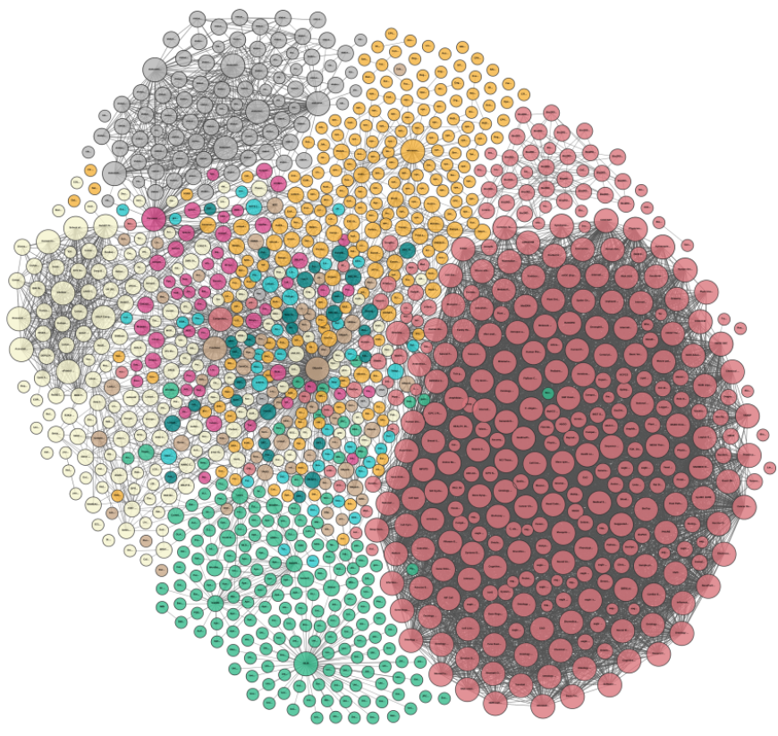
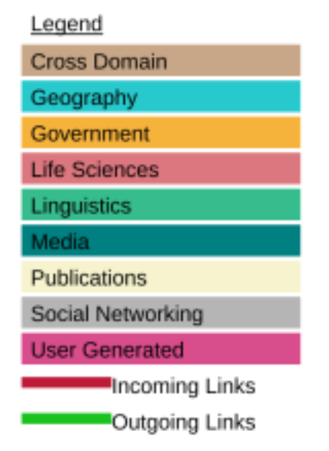
Linking Open Data cloud diagram 2017, by Andrejs Abele, John P. McCrae, Paul Buitelaar, Anja Jentzsch and Richard Cyganiak. http://lod-cloud.net/
Notes:
The LOD "cloud" diagram from August 2017 contains 1163 datasets

Slide 4
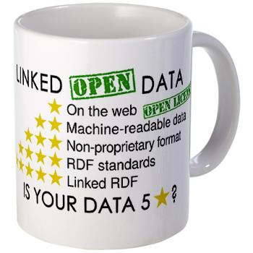
e-Government
Linked Data principles can be used in:
Publishing data
Consuming data
Connecting information systems
Open Data + Linked Data -> Linked Open Data (LOD)

Slide 5
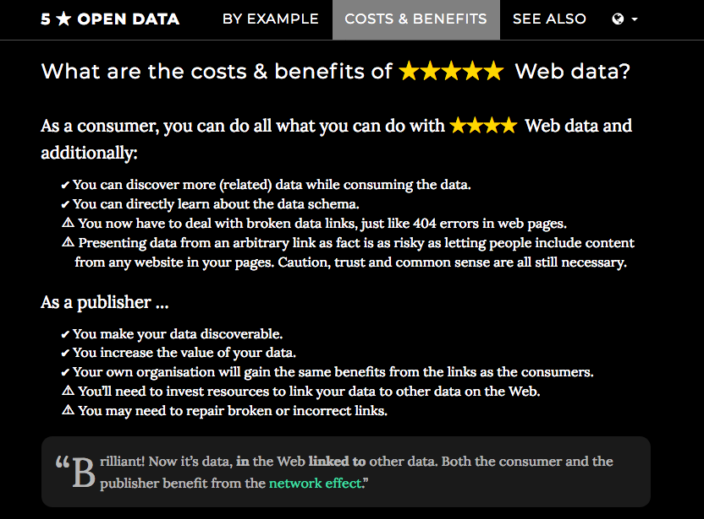
Notes:
Ieguvumi no 4★: Other publishers can link into your data; Granular control over data
http://5stardata.info/en/

Slide 6
Standards & Best Practices
Data on the Web Best Practices (DWBP)
https://www.w3.org/TR/dwbp/
CSV on the Web (CSVW) standards
Model & Metadata Vocabulary for Tabular Data
Data Catalog metadata
DCAT vocabulary; DCAT-AP for EU data portals
RDF Data Cube vocabulary
Publishing multi-dimensional data as Linked Data
More: PROV ontology, Data Quality vocabulary, ...
Notes:
DWBP (2017), CSVW (2015), DCAT (2014), DCAT-AP (2015), PROV (2013), DQV (2016)

Slide 7
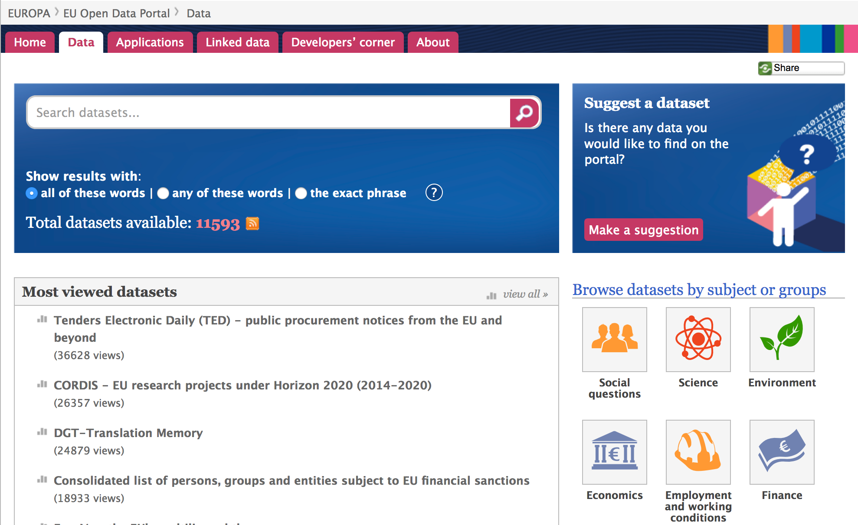
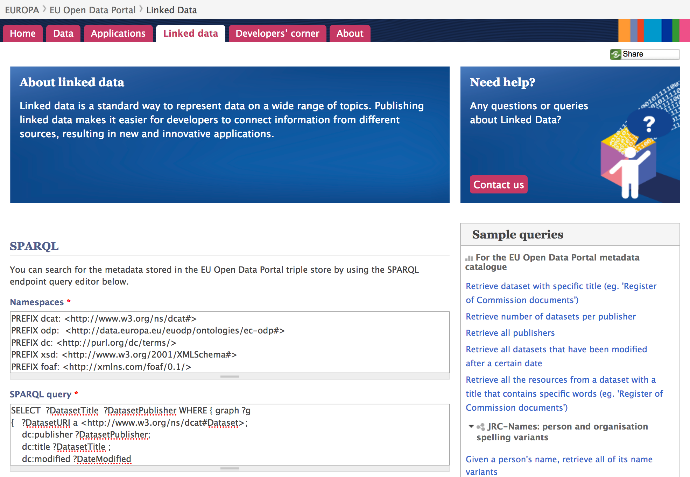
https://data.europa.eu/euodp/en/linked-data
Notes:
SPARQL + Linked Data no kataloga
- tomēr LD te apstājas -> daļai datu kopu pašām nav Linked Data URI

Slide 8
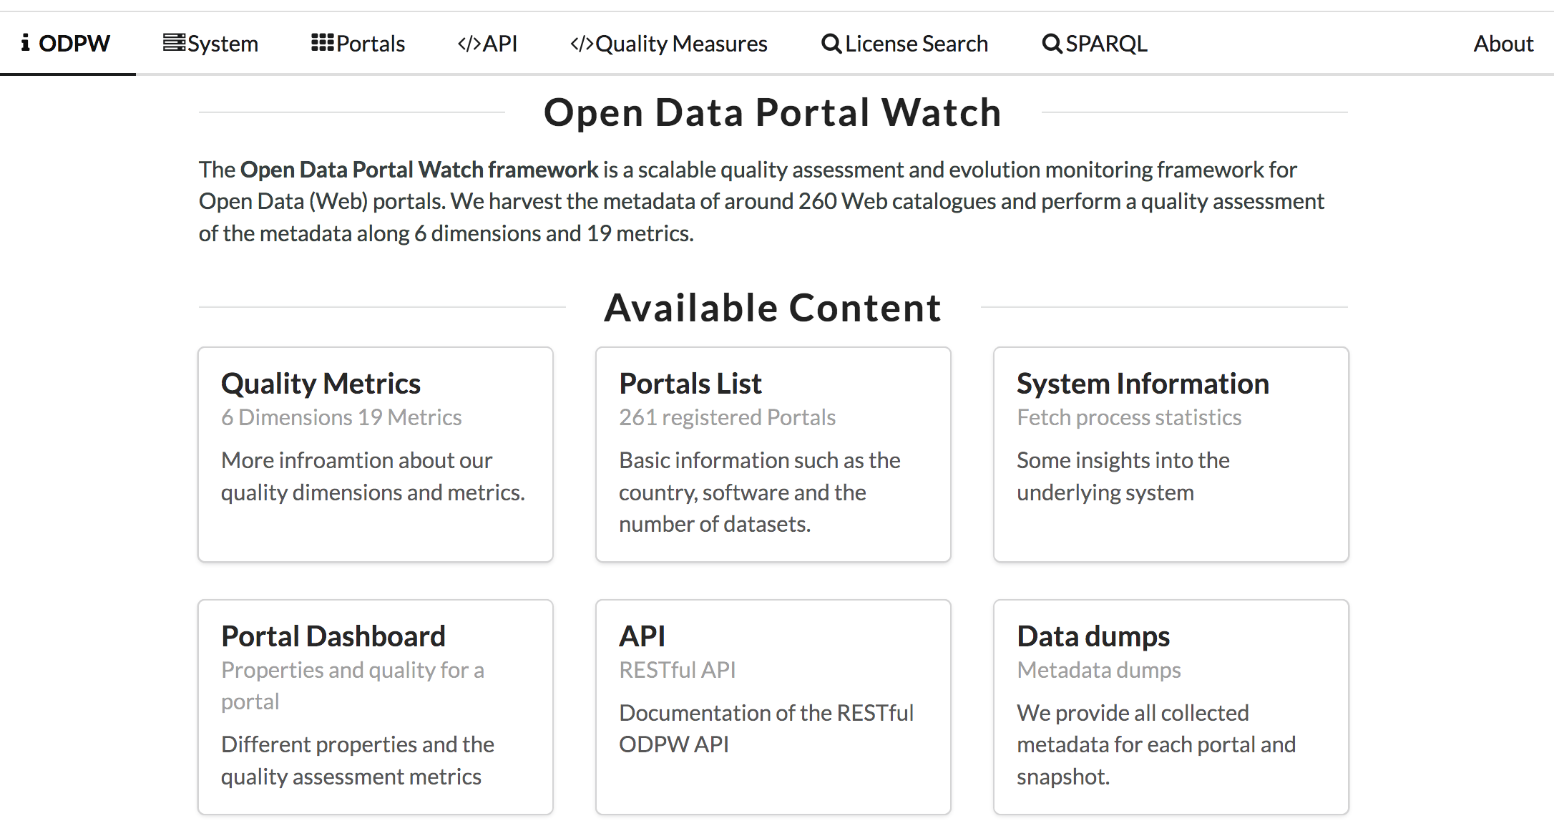
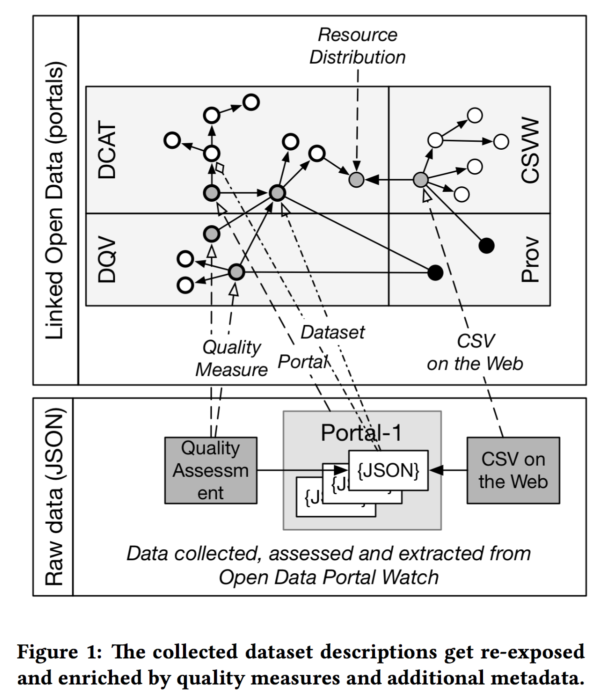
http://data.wu.ac.at/portalwatch/ - Neumaier et al., 2017

Slide 9
Conclusion (e-Gov)
Open Data
Important "bits":
URI identifiers for data objects
Links (between objects, datasets)
Common ontologies / vocabularies
CSV on the Web; JSON-LD
Map existing data to Linked Data
Combining Linked Data with other technologies
Needed:
Tools, infrastructure, guidance (on using LD)
Useful data (!)
Notes:
Ontoloģiju izmantošana valsts pārvaldes datiem -> sadarbība ar UR
(chicken and egg problem?)
Knowlege graphs
Useful data -> prioritize datasets to publish

Slide 10
e-Medicine
Linked Data principles can be used in:
Publishing data
Consuming data
Connecting information systems
Linked Open Data + "Closed" Data

Slide 11
W3C HCLS Interest Group
Goals include:
creating health care and life sciences (HCLS) Linked Data and relevant guidelines
helping organizations create Linked Data
developing RDF vocabularies
creating mappings between HCLS vocabularies
W3C HCLS Linked Data guide (Nov'2012)
https://www.w3.org/2001/sw/hcls/notes/hcls-rdf-guide/

Slide 12
Many HCLS datasets
Datahub.io (245 biomedicine LOD datasets)
BioPortal ( >650 ontologies)
EBI RDF Platform (new version in 2017)
Linked Life Data (data-as-a-service)
OpenPHACTS (EU public-private partnership)
...
Notes:
LD (un SPARQL) kā datu piekļuves / publicēšanas mehānisms grafveida datiem
EBI = EMBL-EBI
Linked Life Data = data-as-a-service (Ontotext)

Slide 13
BioPortal
BioPortal contains:
ontologies
>650 biomedical ontologies (Nov'2017)
ontology metadata
incl. ontology peer reviews
mappings b/w ontologies
user-contributed + automatically generated
Linked Data:
SPARQL endpoint
Linked Data URIs for ontologies and their concepts
https://bioportal.bioontology.org/ - Salvadores et al., 2013
Notes:
LD (un SPARQL) kā datu piekļuves / publicēšanas mehānisms grafveida datiem
Access control (for private ontologies), also for SPARQL access

Slide 14
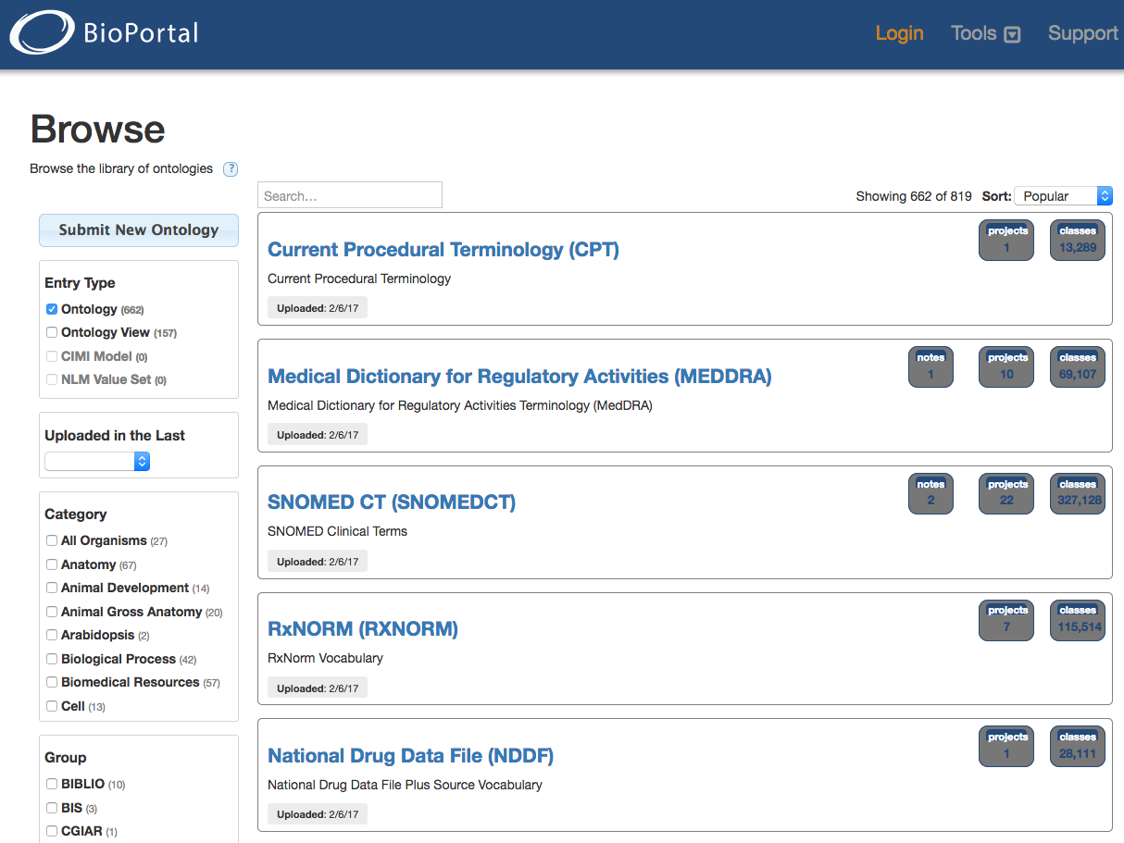
Notes:
we can see that ontologies are large + used in many projects

Slide 15
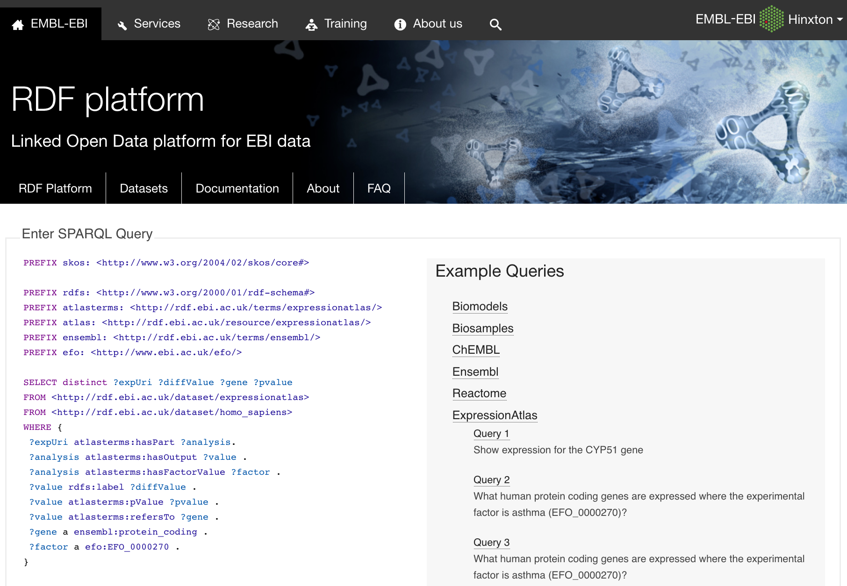
https://www.ebi.ac.uk/rdf - Jupp et al., 2014
Notes:
Developed LODEStar (http://www.ebi.ac.uk/fgpt/sw/lodestar/) - a generic SPARQL endpoint and linked data browser
- with added functionality for querying and browsing EBI-based datasets

Slide 16
OpenPHACTS Open Pharmacological Concepts Triple Store
Goal: to reduce barriers to drug discovery
Open PHACTS Discovery Platform:
integration of pharmacological datasets
Uniprot, Drugbank, WikiPathways, etc.
query service (for the integrated data)
Linked Data Architecture
combined with APIs for data integration / mapping
Notes:
Milzu datu apjoms un pamatīgas prasības infrastruktūrai

Slide 17
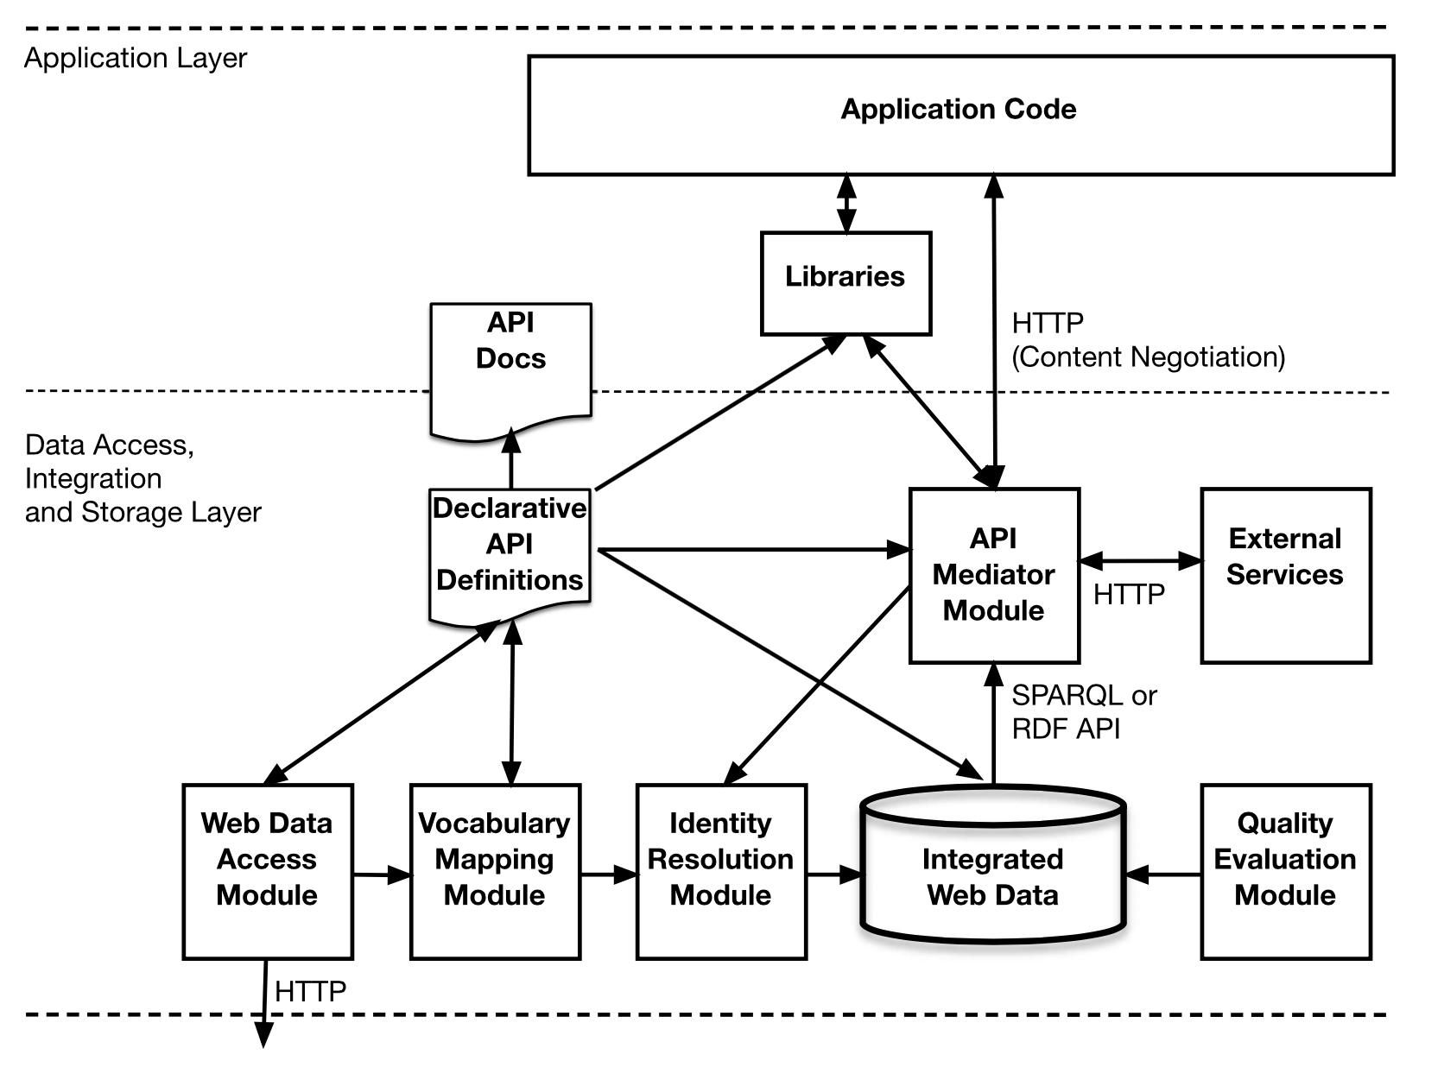
OpenPHACTS Linked Data Application Architecture
Groth et al., 2014

Slide 18
FHIR 3.0
FHIR (HL7) standard for healthcare information
Resource-centric approach / model
Data formats and [REST] APIs
FHIR 3.0 (2017):
support for RDF and Linked Data
https://www.hl7.org/fhir/linked-data-module.html
ShEx rules for FHIR data validation
Opportunities:
Linked Data applications for healthcare
data integration, inference, ...
Notes:
Fast Healthcare Interoperability Resources
need tools for working with ShEx
https://www.hl7.org/fhir/linked-data-module.html

Slide 19
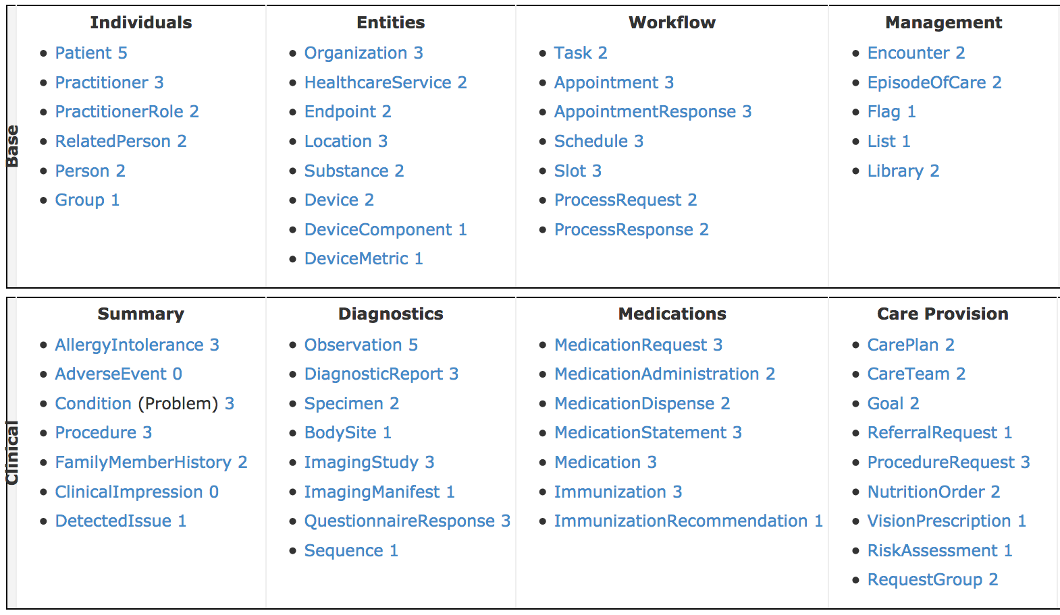
Notes:
Some of FHIR 3.0 Resource types.

Slide 20
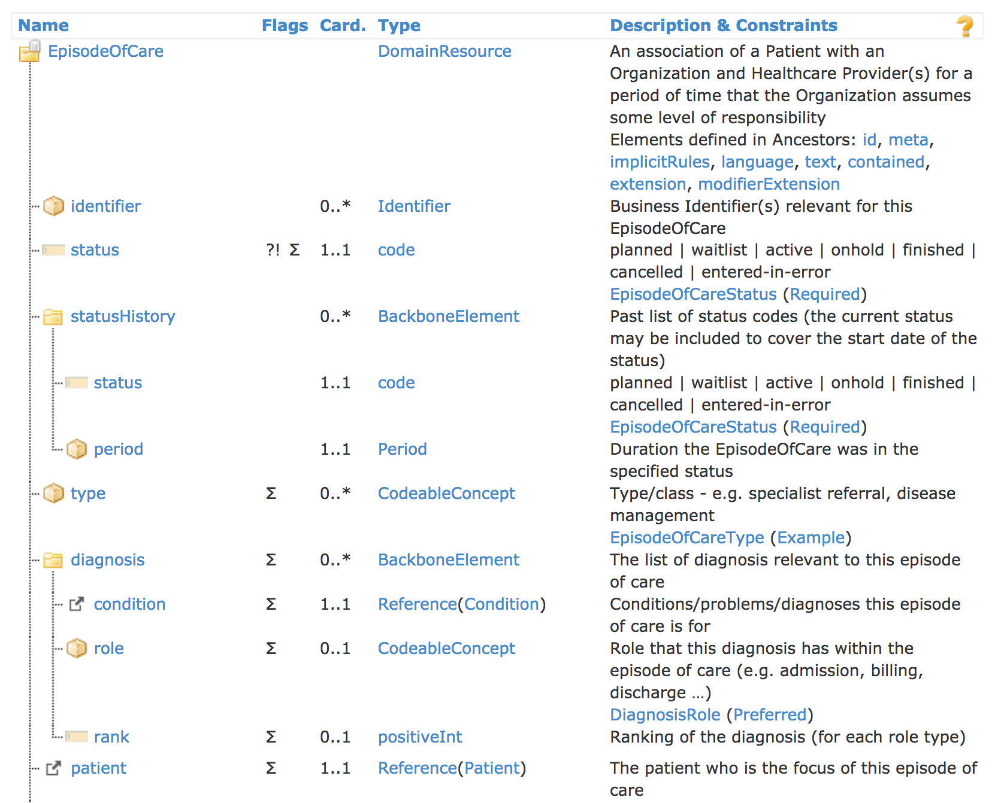
Notes:
https://www.hl7.org/fhir/episodeofcare.html

Slide 21
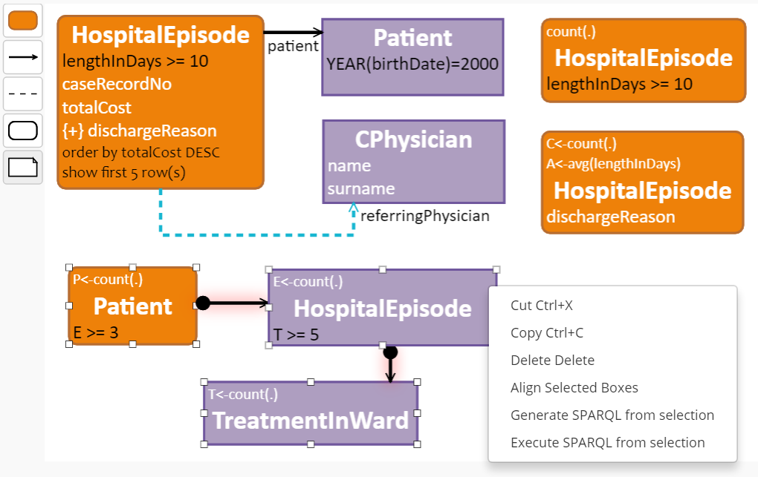
ViziQuer (Čerāns et al., 2017) – visual formulation of SPARQL queries
http://viziquer.lumii.lv/
Notes:
Conclusion (e-Medicine):
Linked Data in one of the components (in the use of RDF in e-Medicine)
Lots of momentum

Slide 22
Conclusion
Active use of Semantic Web in HCLS
many diverse ontologies and datasets
URIs and Linked Data used for data integration
FHIR 3.0 – RDF and Linked Data
potential: Linked Data applications for e-Medicine
Linked Data = one of the building blocks
larger context: RDF, SPARQL, ontologies

Slide 23
General issues
Linked Data & Access Control
combining open and closed data
RDF Data Validation
Shape Expressions (ShEx)
SHACL
Data on the Web Best Practices (DWBP)
URI identifier patterns
Provenance

Slide 24
References
Čerāns, K. et al. (2017) Extended UML Class Diagram Constructs for Visual SPARQL Queries in ViziQuer/web In Voila!2017, CEUR-WS vol.1947.
Groth, P. T. et al. (2014). API-centric Linked Data integration - The Open PHACTS Discovery Platform case study. J. Web Sem., 29, 12–18.
Jupp, S. et al. (2014). The EBI RDF platform: linked open data for the life sciences. Bioinformatics, 30(9), 1338–1339.
Neumaier, S., Umbrich, J., & Polleres, A. (2017). Lifting Data Portals to the Web of Data. WWW2017 Workshop on Linked Data on the Web (LDOW2017), Perth, Australia, April 3-7, 2017.
Salvadores, M. et al. (2013). BioPortal as a Dataset of Linked Biomedical Ontologies and Terminologies in RDF. Semantic Web, 4(3), 277–284.

