Slide 1
Uz ontoloģijām un dziļās mašīnapmācības metodēm balstītas dabīgās valodas semantikas izgūšanas metodes
VPP „SOPHIS” 2.projekts „Uz ontoloģijām balstītas tīmekļa videi pielāgotas zināšanu inženierijas tehnoloģijas"
G.Bārzdiņš, D.Goško, P.Paikens
02/12/2016
Notes:
Lexical ambiguities.

Slide 2
LU MII Uzdevums (1.posms)
Uz lieliem semantiskiem grafiem (piemēram, BabelNet) un notikumu n-āru relāciju grafiem (piemēram, AMR, FrameNet) balstītu dabīgās valodas saprašanas (language understanding) metožu teorētisko pamatu izstrāde.
  Sagatavota zinātniskā publikācija

Slide 3
LU MII Uzdevums (2.posms)
Turpināt attīstīt SemEval-2015 konkursā veiksmīgi startējušo C6.0 klasifikācijas algoritmu, uz tā bāzes iesaistīties starptautiskās pētniecības iniciatīvās
  Sagatavota zinātniska publikācija vai sagatavots H2020 projekta pieteikums (2 pubikācijas, 1 H2020 projekts ar LETA)
SemEval-2015 konkurentu risinājumu izpēte un labāko metožu integrācija latviešu valodas semantiskās analīzes rīkkopā (tiek lietota LETA un citur)
  Rīkkopas uzlabota versija (izstrādāta un ieviesta LETA)

Slide 4
LU MII Uzdevums (3.posms)
Piedalīšanās SemEval-2016 starptautiskajā sacensībā ar uzlabotu C6.0 klasifikācijas algoritma versiju, kas pielāgota "Abstract Meaning Representation" (AMR) izgūšanai no dabiskās valodas teksta.
  Sagatavota zinātniskā publikācija vai zinātniskais pārskats

Slide 5
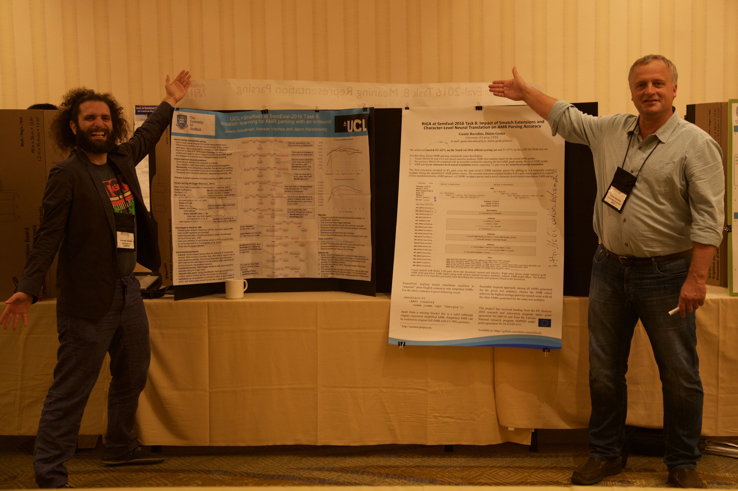

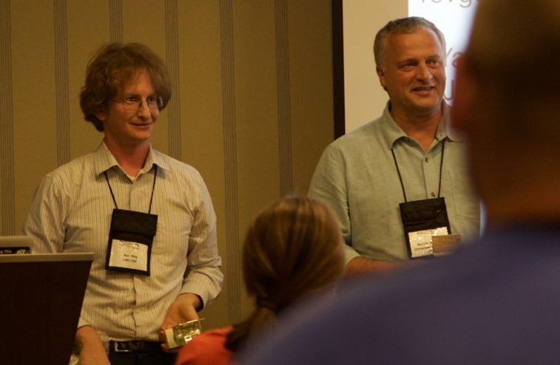
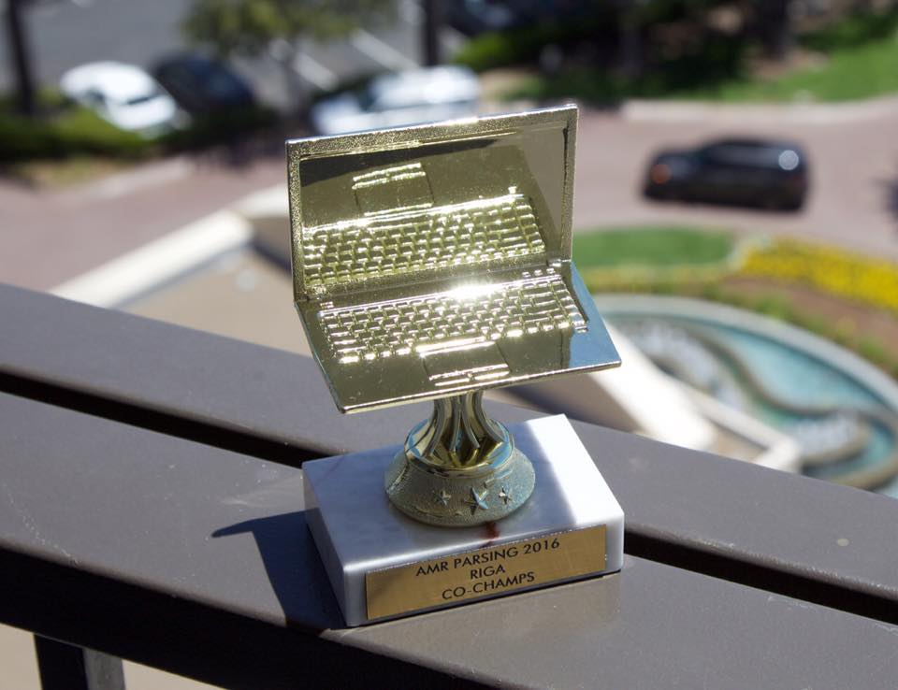
Uzvara SemEval-2016, Task 8:
Meaning Representation Parsing (AMR)
RIGA (University of Latvia, IMCS; LETA): 0.6196
CAMR (Brandeis University; Boulder Learning Inc.;Rensselaer Polytechnic Institute): 0.6195
ICL-HD (Ruprecht-Karls-Universität Heidelberg): 0.6005
UCL+Sheffield (University College London; University of Sheffield): 0.5983
M2L (Kyoto University): 0.5952
CMU (Carnegie Mellon University; University of Washington): 0.5636
CU-NLP (OK Robot Go, Ltd.; University of Colorado): 0.5566
UofR (University of Rochester): 0.4985
MeaningFactory (University of Groningen): 0.4702
CLIP@UMD (University of Maryland): 0.4370
DynamicPower (National Institute for Japanese Language and Linguistics): 0.3706
http://summa-project.eu/blog/leta-wins-amr-parsing-trophy-at-semeval-2016/

Slide 6
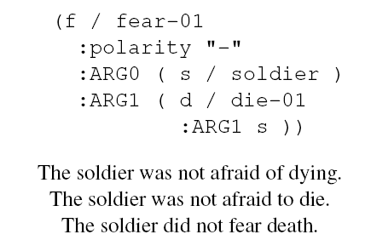
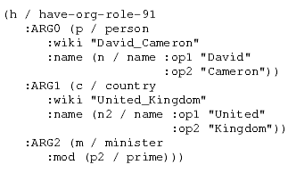
Publikācija SemEval-2016, Task 8:
Meaning Representation Parsing (AMR)
Guntis Barzdins, Didzis Gosko. RIGA at SemEval-2016 Task 8: Impact of Smatch Extensions and Character-Level Neural Translation on AMR Parsing Accuracy. Proceedings of the 10th International Workshop on Semantic Evaluation (SemEval-2016), SanDiego CA, Association for Computational Linguistics, pp. 1143-1147. (http://aclweb.org/anthology/S16-1176)
Mūsu open-source AMR parseris ātrakais un precīzākais pasaulē, tiek izmantots H2020 SUMMA projektā, NIST TAC-KBP sacensībā un citur

Slide 7
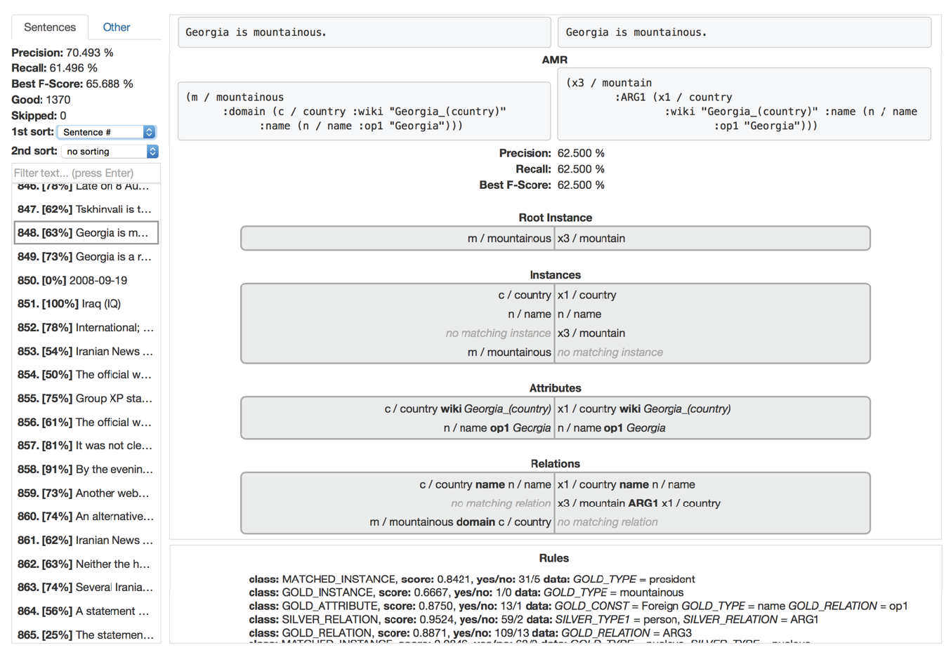
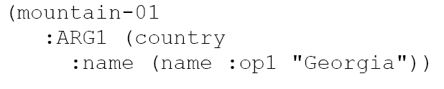

Novel AMR parsing methods
F1=66%
F1=43%
F1=97%
Smatch Extended with C6.0 Character-Level Neural Translation
for systematic error spotting English → simplified AMR
and deterministic extension to AMR
Ensemble: F1=67% (62% on the official scoring set)

Slide 8
Citas publikācijas: EN → LV
N. Gruzitis and G. Barzdins. The role of CNL and AMR in scalable abstractive summarization for multilingual media monitoring. Controlled Natural Language, Controlled Natural Language 5th International Workshop, CNL 2016, Davis, Brian, Pace, Gordon J., Wyner, Adam (Eds.), LNAI, Volume 9767, pp. 127-130, Springer 2016. doi = "10.1007/978-3-319-41498-0" (to be indexed SCOPUS)
Peteris Paikens. Deep Neural Learning Approaches for Latvian Morphological Tagging. Frontiers in Artificial Intelligence and Applications, Volume 289: Human Language Technologies – The Baltic Perspective, I. Skadiņa and R. Rozis (Eds.). IOS Press, 2016, pp 160-166. DOI 10.3233/978-1-61499-701-6-160 http://ebooks.iospress.nl/volumearticle/45531 (to be indexed SCOPUS)

Slide 9

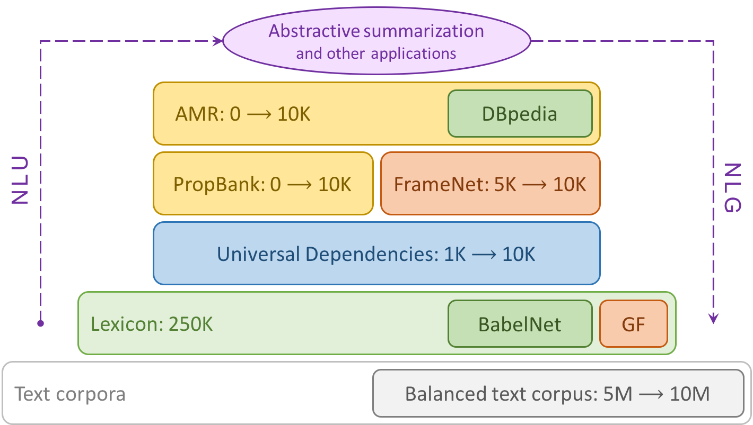
full
stack
Abstractive text summarization is emerging as a hot topic in natural language understanding (NLU) and natural language generation (NLG). Unlike extractive summarization which selects few informative sentences, abstractive summarization requires full-stack semantic parsing, salient content identification and coherent text generation.
The project industrial partner, National news agency LETA, requires text summarization for media monitoring. The research partner, Artificial Intelligence Laboratory at IMCS, University Latvia, has extensive experience in both state-of-the-art semantic parsing and creation of annotated language resources.
The goal of the project is to create multi-layered semantically annotated language resources for Latvian, anchored in widely acknowledged multilingual representations (AMR, PropBank, FrameNet, Universal Dependencies, Grammatical Framework, BabelNet, DBpedia), and showcase their use for developing an advanced Latvian abstractive text summarizer to be evaluated both on the media monitoring use case and with ROUGE and other metrics. This project will boost the NLU and NLG research and innovations for Latvian.

Slide 10



Full Stack of Language Resources for Natural Language Understanding and Generation in Latvian projekts
full
stack
Latvijas Universitātes
Matemātikas un informātikas institūta
Mākslīgā intelekta laboratoriju (AI-Lab)

Slide 11
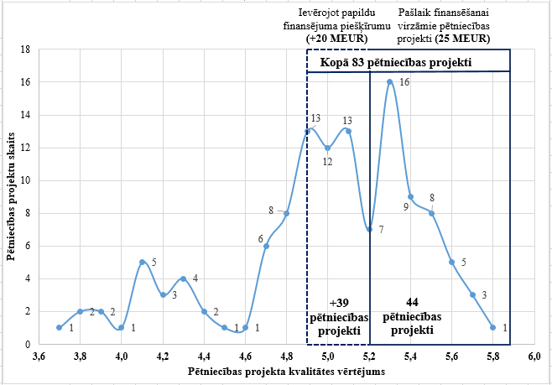
full
stack
Total overall Budget: 600 K€
Total timing of the project: 3 years
Start date: December 1, 2016

Slide 12
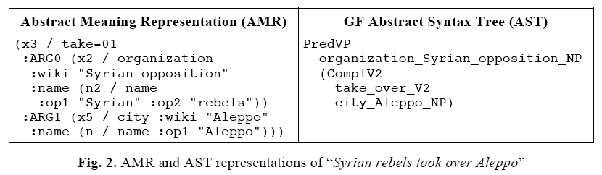
Citi nākotnes plani (1)
Piedalīties SemEval-2017, Task 9: Abstract Meaning Representation (AMR) Parsing and Generation
  Kopā ar IBM Brazīlija, Chalmers University, Tohoku university
  Tekstrade izmantojot AMR→GF konvertāciju un neironu mašīntulkošanu

Slide 13
Citi nākotnes plani (2)
Immitation Learning
  Apvieno Deep Learning (Reinforcement Learning with SGD) un Episodic Memory (one-shot learning)
Deep Learning
Episodic Memory
Mācās lēni ar SGD
One-shot learning

Slide 14
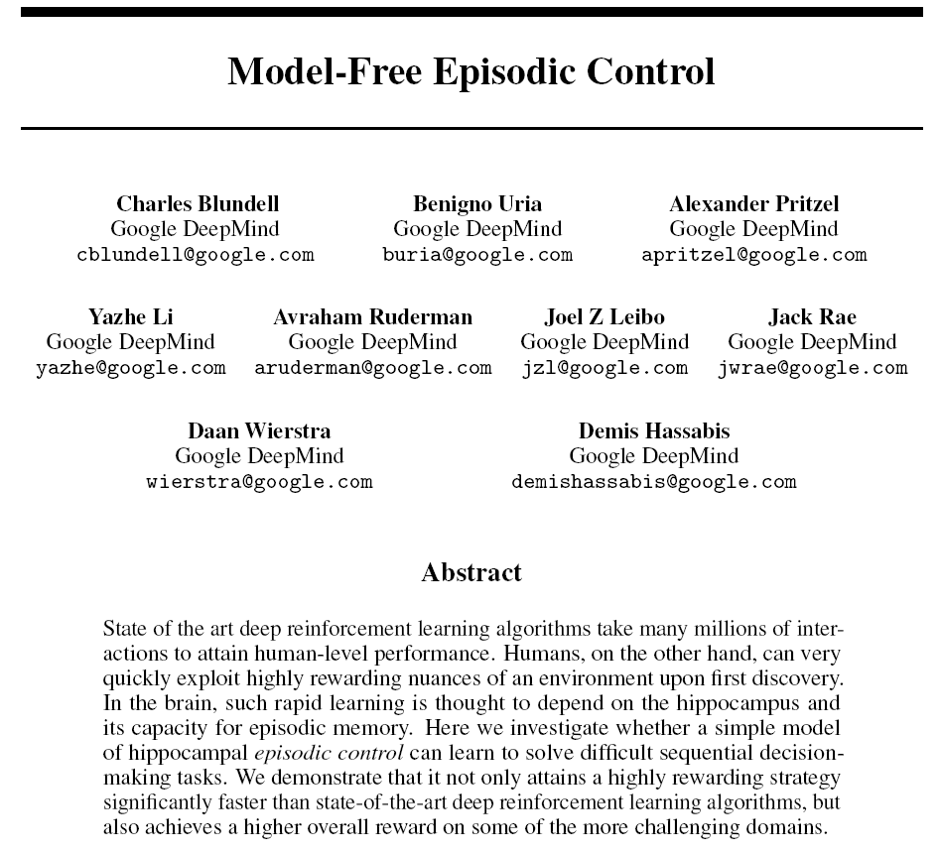
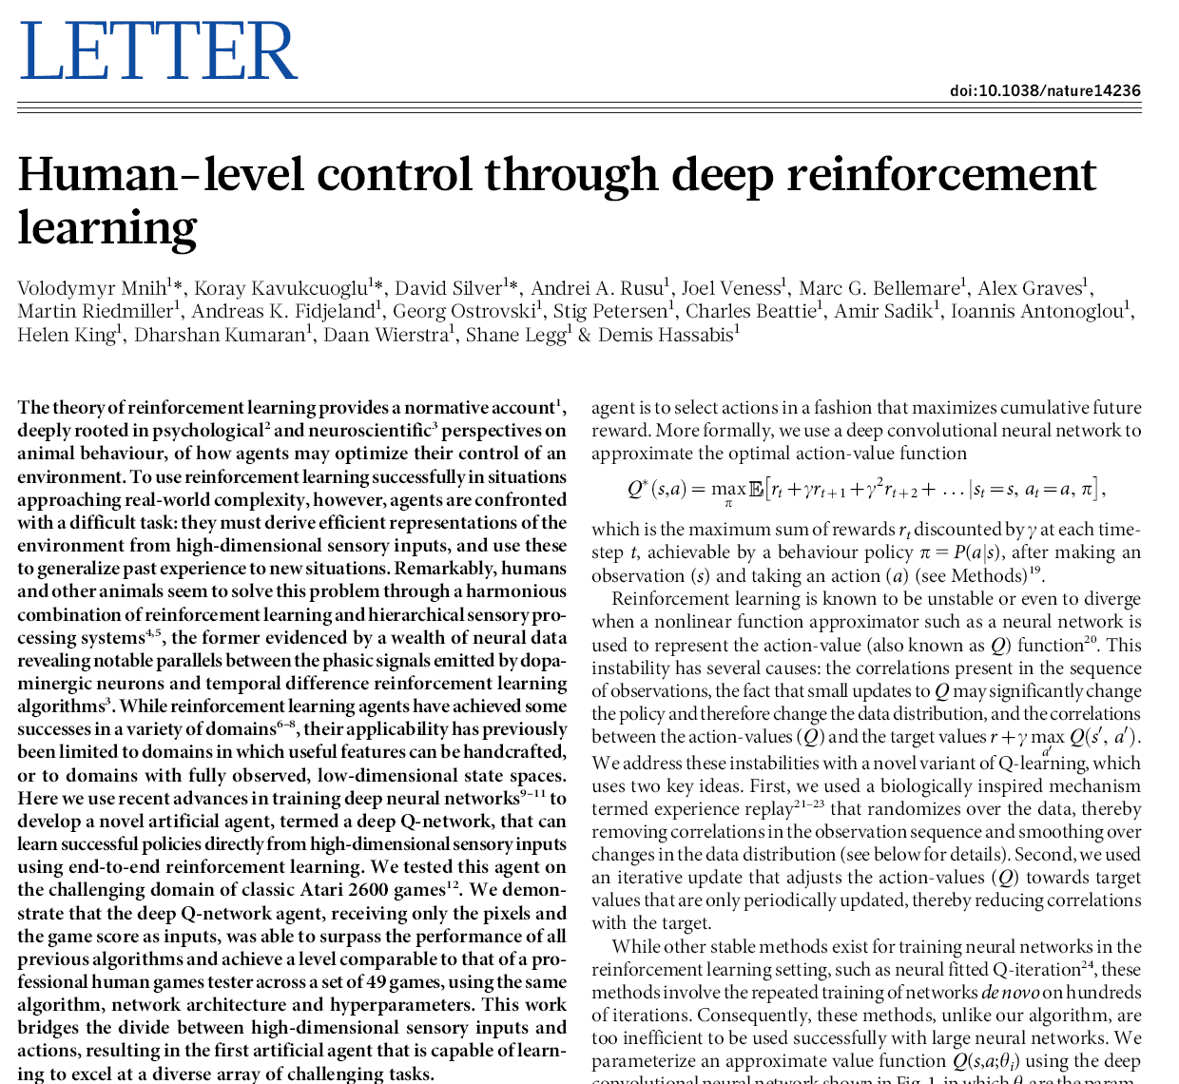
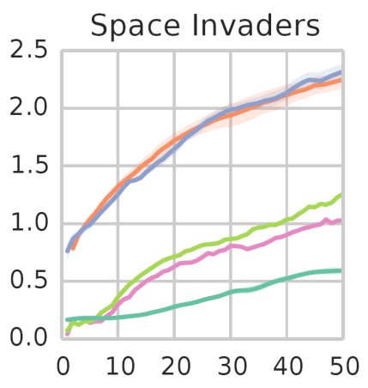
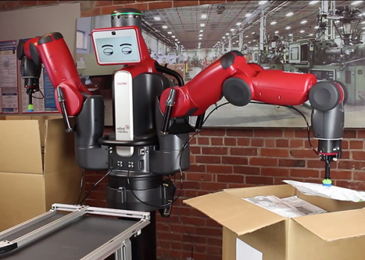
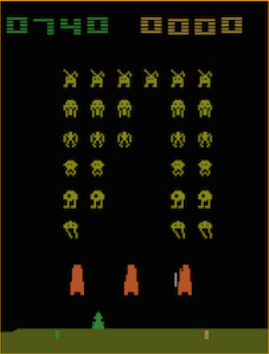
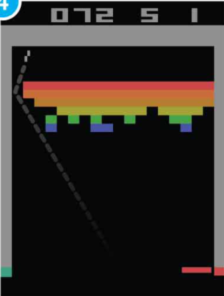
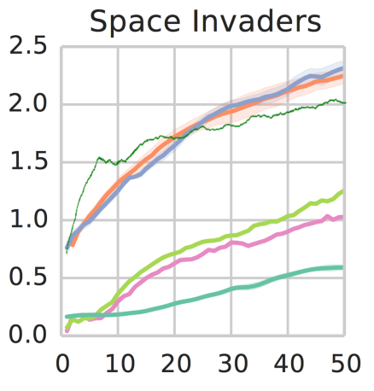
Atari games → Robotics
http://www.nature.com/nature/journal/v518/n7540/full/nature14236.html
https://github.com/kuz/DeepMind-Atari-Deep-Q-Learner
http://people.idsia.ch/~juergen/naturedeepmind.html
https://www.youtube.com/watch?v=V1eYniJ0Rnk
arXiv:1606.04460v1 [stat.ML] 14 Jun 2016
Nature, 518(7540):529–533, 2015.

Slide 15
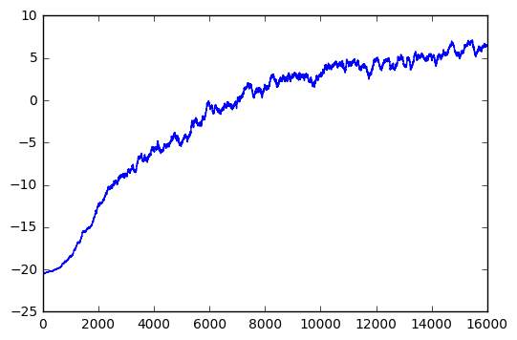
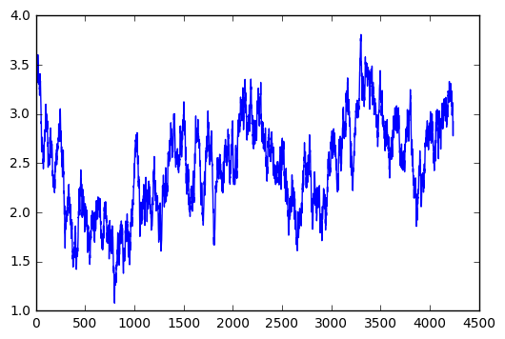
Immitation Learning
Robots B skatās kā A spēlē 10
epizodes un arī iemācās uzvarēt Pong
Robots A iemācās uzvarēt Pong

Slide 16
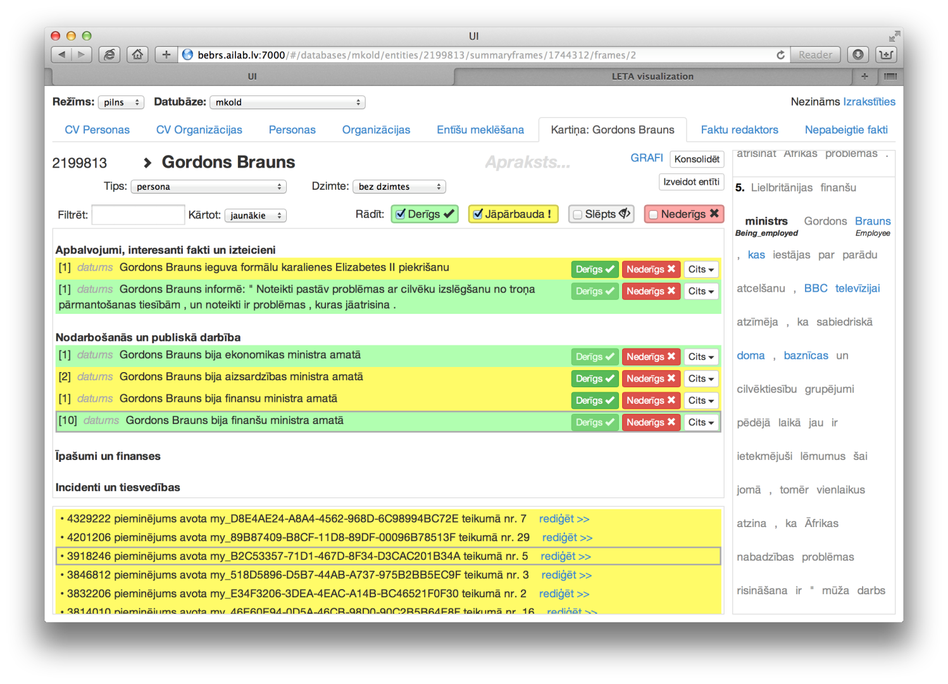
Citi nākotnes plani (3)
Dalība NIST TAC-KBP Cold Start sacensībā
  Iegūto rezultātu integrācija LETA ontoloģijas automatiskā profilu izgūšanas sistēmā
  Data Science metožu izpēte un integrācija

Slide 17
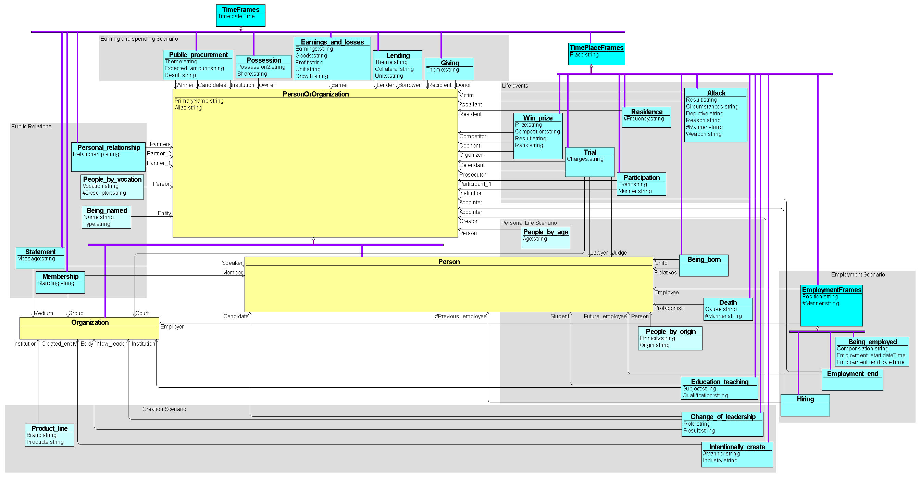
LETA ontoloģija Ver. 26/02/2015

Slide 18
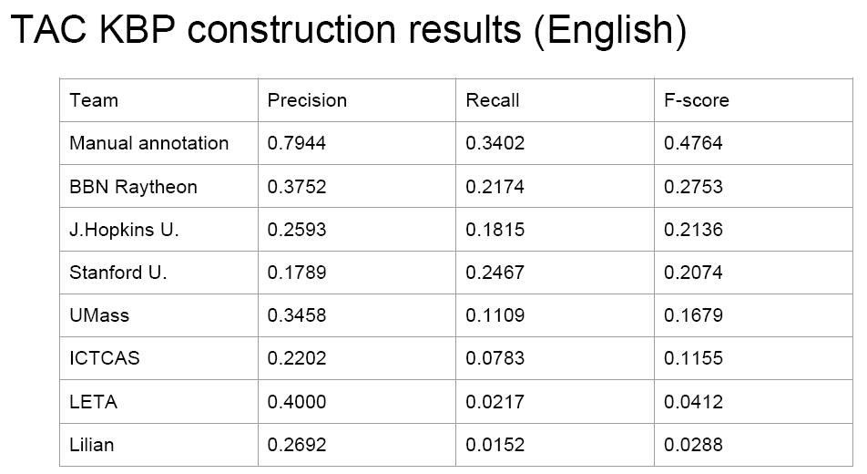
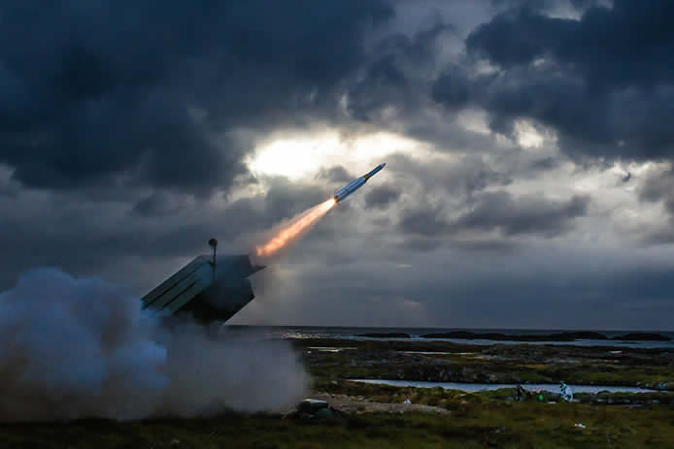
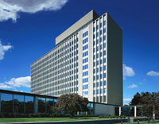
Rezultātu salīdzinājums
Text Analtics Conference, Knowledge Base Population
Conducted by:
U.S. National Institute of Standards and Technology (NIST)
With support from:
U.S. Department of Defense
TAC 2016 Workshop
November 14-15, 2016
National Institute of Standards and Technology
Gaithersburg, Maryland USA
SUMMA
LETA Profile exractor (Latvian) precizitāti raksturo sekojoši rādītāji:
ALL TARGETS Precision = 68.9%; Recall = 81.3%; F1 = 74.6%
ALL ELEMENTS Precision = 85.4%; Recall = 70.1%; F1 = 77.0%
TOTALLY CORRECT FRAME WITH 1 ELEMENT F1 = 57.5%
TOTALLY CORRECT FRAME WITH 2 ELEMENTS F1 = 33.0% <-- šis tuvs TAC-KBP labākajam rez.
TOTALLY CORRECT FRAME WITH 3 ELEMENTS F1 = 19.0%
TOTALLY CORRECT FRAME WITH 4 ELEMENTS F1 = 10.9%

