Slide 1
Runtime Verification of Business Processes
Jānis Bičevskis, University of Latvia

Slide 2
Uzdevumi
1. Tālāk attīstīt metodes liela apjoma datu pieejamībai, kas balstītas uz modeļiem un nozares ontoloģijām, piedāvājot jaunas tīmekļa videi piemērotas datu atlasīšanas un vizualizācijas metodes.
Sagatavota zinātniskā publikācija
2. Tālāk attīstīt biznesa procesu modeļu pielietošanas metodes programmas izpildes laika notikumu analīzē, lai paaugstinātu informācijas sistēmu drošības līmeni.
Sagatavota zinātniskā publikācija

Slide 3
Rezultāti
Rudolfs Bundulis, Guntis Arnicans. Use of H. 264 real-time video encoding to reduce display wall system bandwidth consumption. In Information, Electronic and Electrical Engineering (AIEEE), 2015 IEEE 3rd Workshop on Advances in, pp. 1-6. IEEE, 2015.
DOI: 10.1109/AIEEE.2015.7367298, http://ieeexplore.ieee.org/xpl/articleDetails.jsp?arnumber=7367298
Ingars Ribners, Guntis Arnicans. Concept of Client-Server Environment for Agent-Based Modeling and Simulation of Living Systems. In Computational Intelligence, Communication Systems and Networks (CICSyN), 2015 7th International Conference on, pp. 83-88. IEEE, 2015.
DOI: 10.1109/CICSyN.2015.25 (būs Scopus)

Slide 4
Rezultāti
Janis Bicevskis, Zane Bicevska and Ivo Oditis. Self-management of Information Systems. Baltic DB&IS 2016 (pieņemts, būs Scopus).
Zane Bicevska, Janis Bicevskis and Girts Karnitis. Models of Event Driven Systems. Baltic DB&IS 2016 (pieņemts, būs Scopus).

Slide 5
Security
Information security is defined within the standard in the context of the C-I-A triad:
the preservation of confidentiality (ensuring that information is accessible only to those authorized to have access),
integrity (safeguarding the accuracy and completeness of information and processing methods)
availability (ensuring that authorized users have access to information and associated assets when required).
ISO/IEC 27002 provides best practice recommendations on information security management.

Slide 6
Processes define activity
proceses
staff
systems
Notes:
Man liekas, ka šo varētu izmest

Slide 7
Initial question
Does business process runs correctly?
Process can run over more than one IS
Environment is changing
May be process instance is late?
Some processes only partly are supported by IS

Slide 8
Quality assurance
Static analysis – software is verified without execution
Dynamic analysis – software verification using test examples in the testing environment
Runtime verification – software is verified continuously during runtime in the live environment

Slide 9
Main objectives
Provide verification for processes without built-in verification mechanism
Provide verification for processes running in heterogeneous environment
Provide early warning and error messaging system
Provide easy and dynamic definition of process verification descriptions

Slide 10
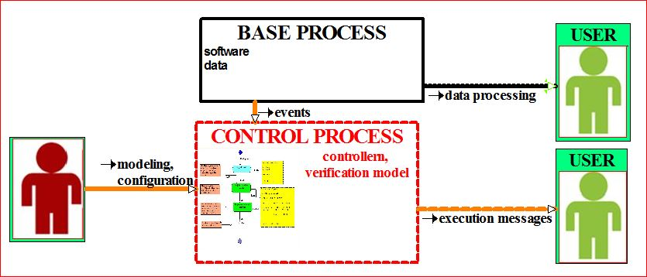

Slide 11
Correctness criteria
Process is executed by legal execution path
Required actions are executed
Execution time limits are not violated

Slide 12
Proposed solution
Verification process is designed for each base process
Controller verifies process execution using process verification description
Process execution events are detected by agents

Slide 13
Process verification description language
Base element – event describing activity:
type
parameters
agent & address
timing (fixed time or relative)
Event order
Events may have «subevents»
Variables are used to link events

Slide 14
Lessons learned by prototyping
Rather detailed base process execution model must be available
Agent delays and some peculiarities should be taken into account
Agents must be developed with minimum overhead for runtime environment:
event-based recomended

Slide 15
Summary
Solution is applicable for heterogeneous environment
No changes are required in running systems
Set of agents may be supplements without any changes in controller or verification process descriptions
Solution is applicable for wide area of problems:
high level business processes
document processing systems
time critical data processing systems

Slide 16
Thank you for attention!
Questions?

