Slide 1


Measurement of current consumption in a wireless sensor network TestBed
Didzis Lapsa, Rihards Balass, Janis Judvaitis, and Krisjanis Nesenbergs
Institute of Electronics and Computer Science
Dzērbenes iela 14, Rīga, Latvija
e-mail: didzis.lapsa@edi.lv

Slide 2
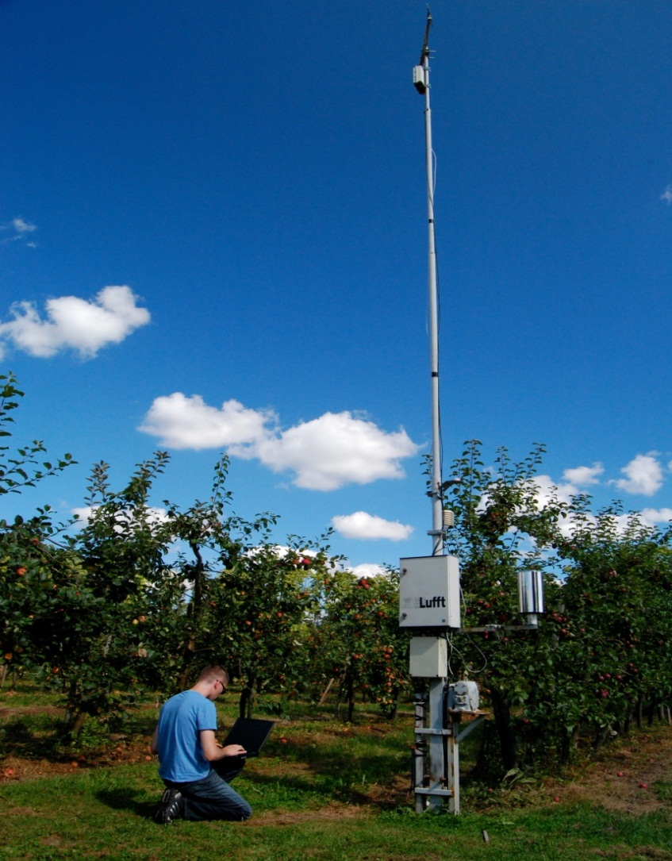
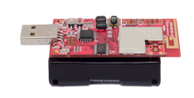



Wireless Sensor Networks
Sensor nodes are measuring intensity of sunlight
Base station
( ( ( Wireless comunication ) ) )

Slide 3
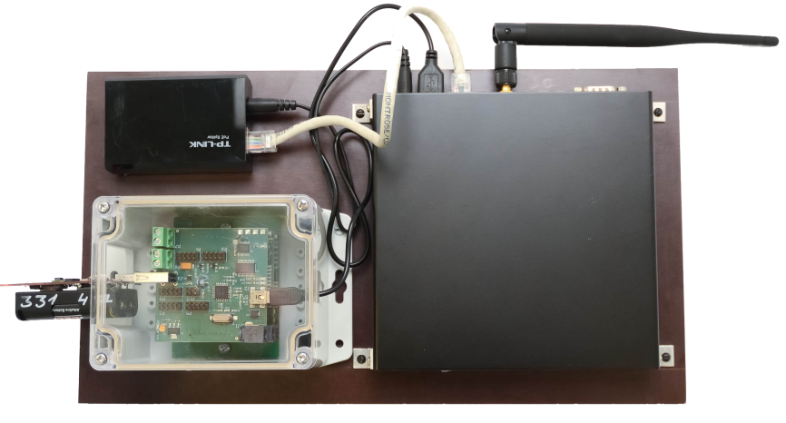

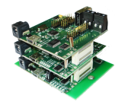
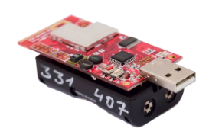
TestBed architecture design
Power Over Ethernet (POE) splitter, sepatertes Power from Ethernet
Workstation is powered by power over ethernet.
Workstation
consists of router, TestBed adapter and sensor node
Testbed adapter is implemented in the workstation

Slide 4
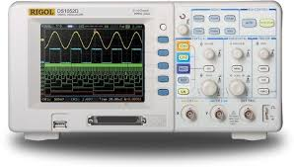
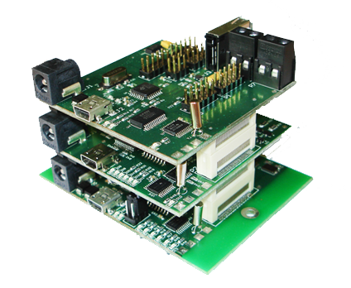
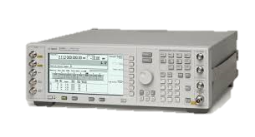
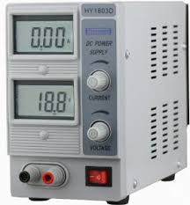
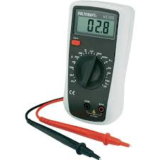
TestBed adapter
Oscilloscope
TestBed adapter combines a primitive functionality of these facilities
Signal generator
Power supply
4.7 – 0.7V
Multimeter

Slide 5
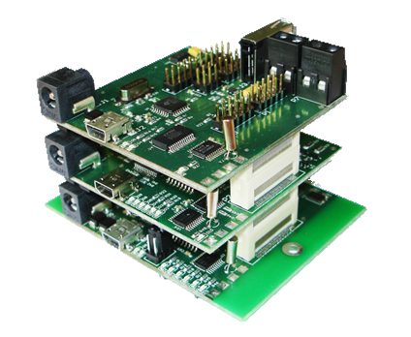
TestBed adapter
Communication module
It has USB support. Allows to programm DUT
Allow to program DUT
Debug
Power consumption measurement
Communication between router and DUT
On-board data storage
PWR module
Allows measure power consumtion and set output voltage
Signal conversion module
Proccesing and storing recaived data from DUT
Each module has it’s own Tiny MCU, wich can be programmed using Spy-Bi-Wire interface

Slide 6
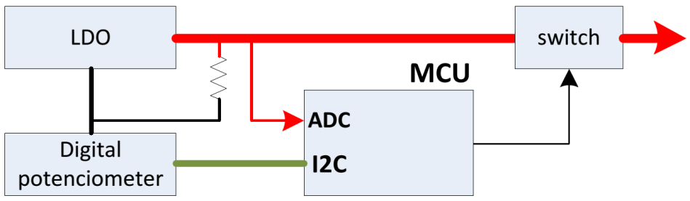
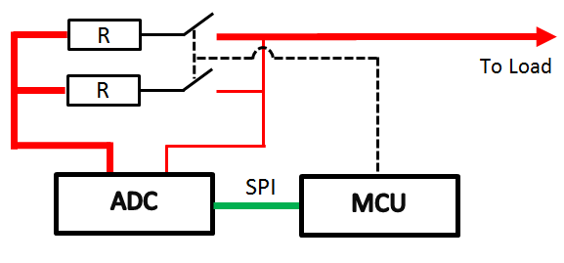
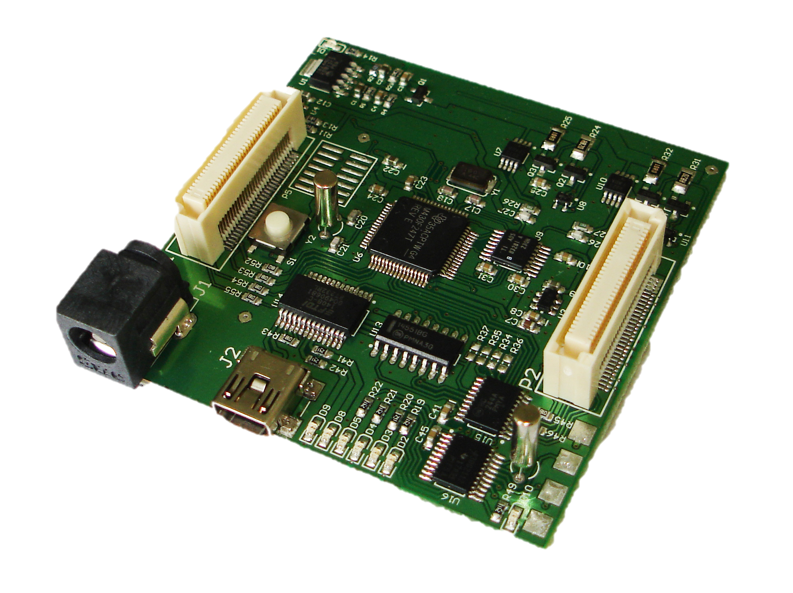
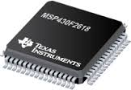
Current consumption module
Komunikācijas modulis
Adjustable voltage
Power support
Current measurement
Batery discharge
Store data in SD card
Interrup capability
Individual operation mode
MCU

Slide 7
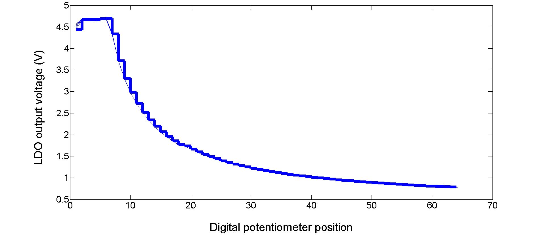
Battery discharge curve

Slide 8
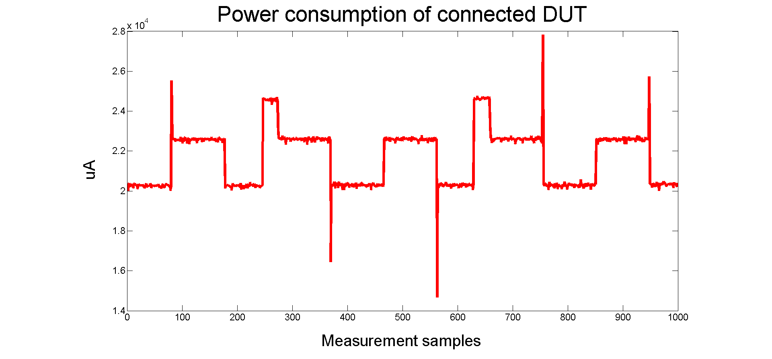
TB-adapter current measurement

Slide 9
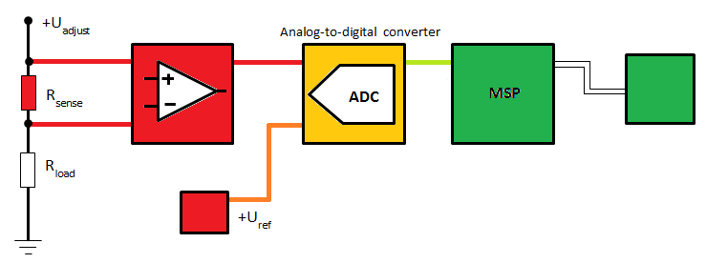
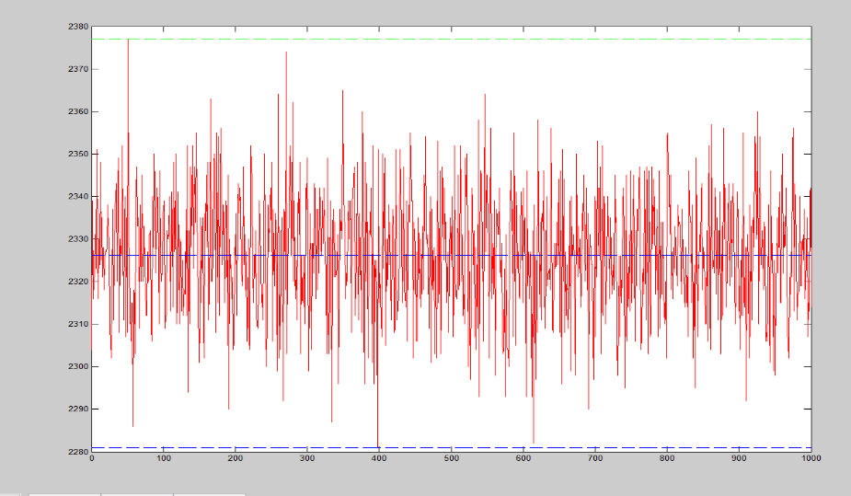
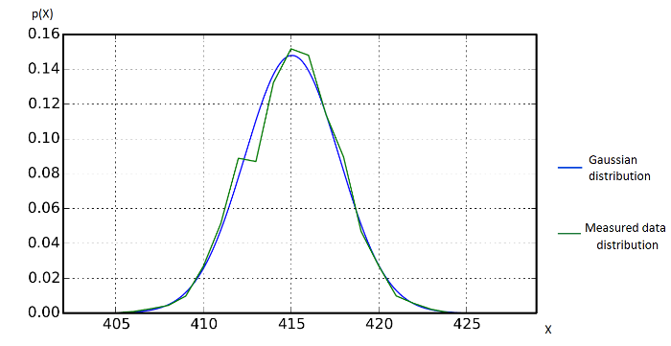
Current sense in TB-adapter
UART- USB
Block diagram representation of the current sensing principle

Slide 10
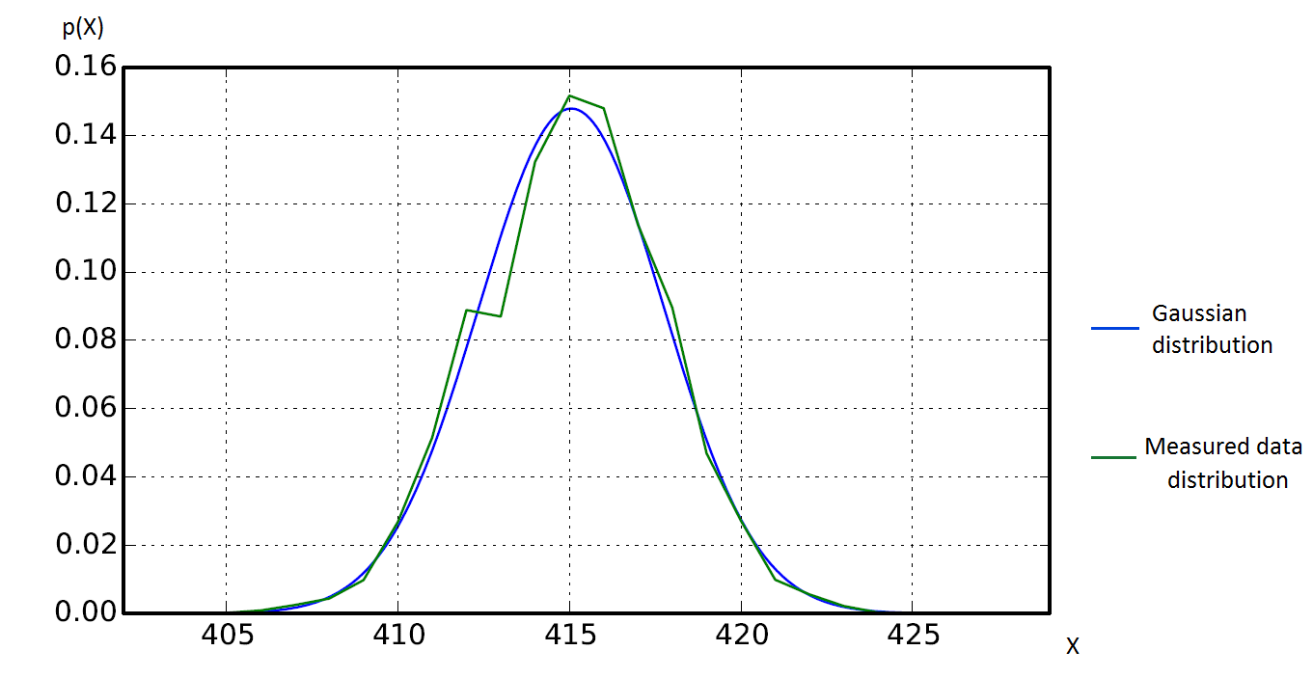
Noise in TB-adapter
UART- USB
Block diagram representation of the current sensing principle

Slide 11
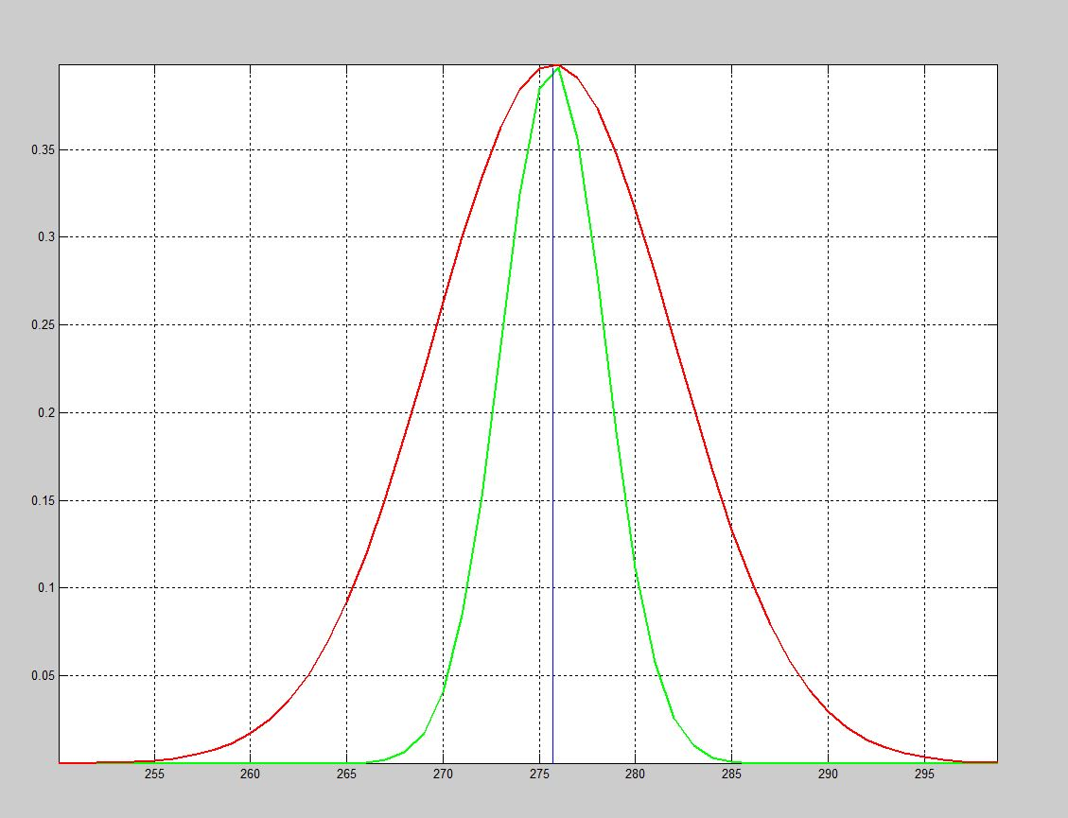
Measurement improvements
P(x)
Improvement 50% of
quality by adding noise
filters
Side effect is measutred
value drift
Results before improvement
Results after improvement
x

Slide 12
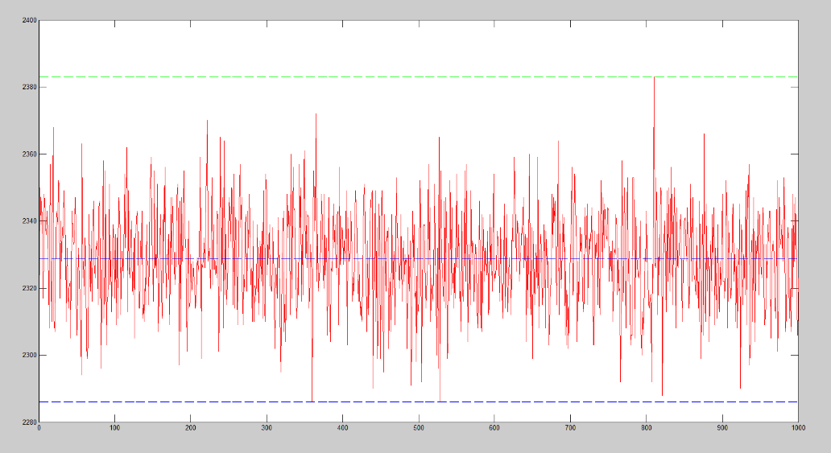
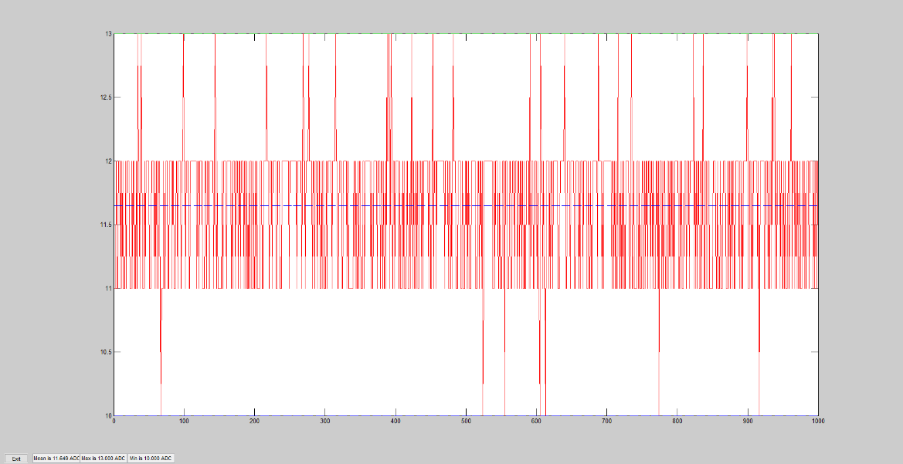
Data processing in TB-adapter
Data processing to reduce the noice.
Involves powerful system upgrades and more data saves in to RAM

Slide 13
TestBed architecture design
Power Over Ethernet (POE) splitter, sepatertes Power from Ethernet
Workstation is powered by power over ethernet.
Workstation
consists of router, TestBed adapter and sensor node

Slide 14
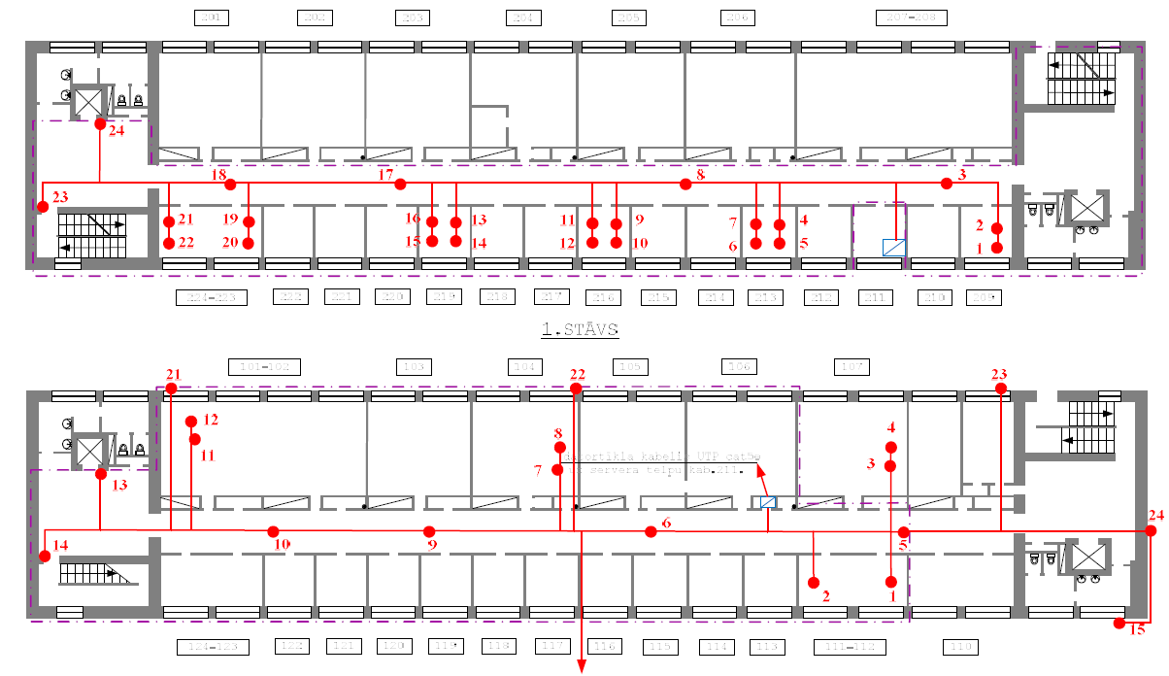
TestBed architecture design
40 workstations are placed across seven floars.
We have plast 90 workstations acros 7 floors, but 10 are placed out of building. To imitate real-word environment.
We have a working WSN architecture and we can access local network through internet, program, reprogram and test senssor nodes. Collect and process data.

Slide 15
Thanks for Your attention.

